Slide 1

Stock Market Volatility: Patterns and Predictions
Zhijun He Phoebe Pan

Slide 2
Proposal
Analyze historical stock market fluctuations from 2000-2025
Examine how major economic, political, and global events impact market volatility across different sectors
Analyze comprehensive market data to identify patterns that precede significant market movements
Evaluate the effectiveness of various prediction models in anticipating market corrections and rallies
Project Description:
Expected Outcome:
A comprehensive analysis of market volatility patterns from 2000-2025
Identification of leading indicators for market shifts
Evaluation of prediction model performance across different market conditions
Interactive visualization dashboard for exploring market volatility patterns
Recommendations for investors based on historical pattern analysis

Slide 3
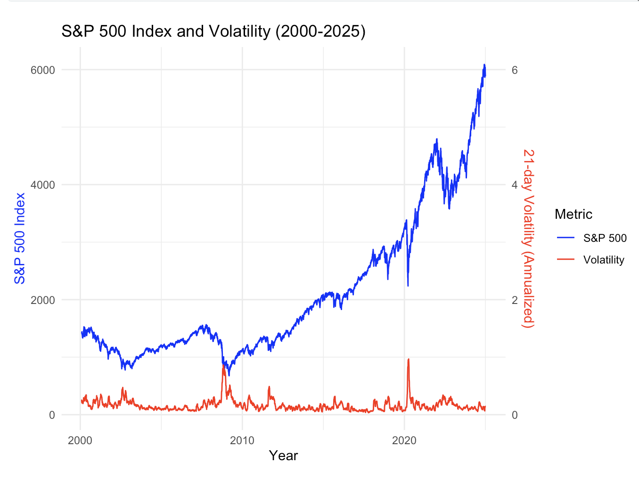
the dramatic inverse relationship during crisis periods
Notes:
The stock market volatility serve as an important indicator of market performance, take this line plot for example, we can see around the 2008 financial crisis and the 2020 pandemic era the volatility and the S&P 500 index exhibit a dramatic inverse relationship pattern. Let’s take a step further and look at the volatility pattern across different major markets and sectors.

Slide 4
Data Collection
01
02
03
Data source
The International Monetary Fund (IMF) and Yahoo Finance
Goal
Examine volatility patterns across major global markets
Data Overview
Stock market index from 2000 to 2025 In the United States, United Kingdom, Japan, Germany, France, and China
Notes:
We will be using data sourcing from the IMF and yahoo finance to examine the …. The data include stock market index from 2000 to 2025 in …

Slide 5
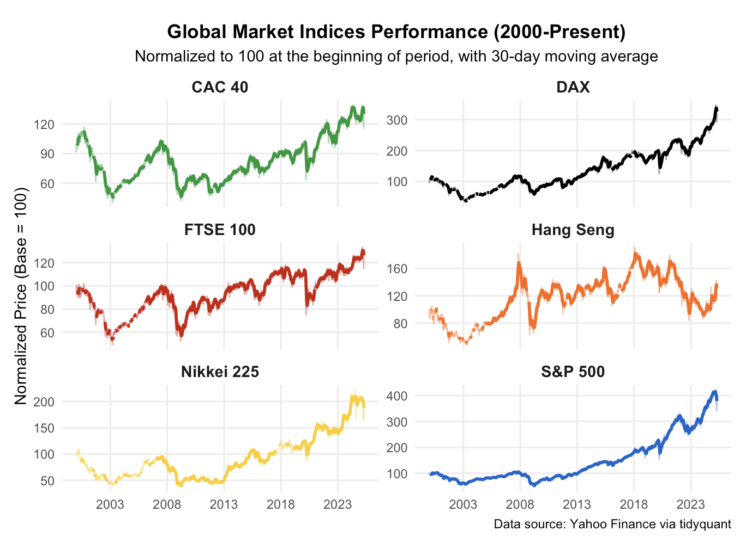
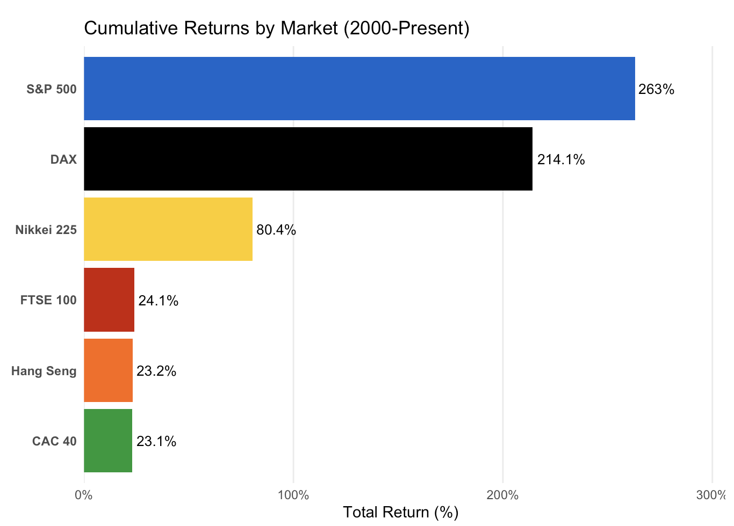
Divergence among regions - Return
Notes:
Firstly we can observe the return divergence among regions over more than two decades, highlighting their relative performance when normalized to the same starting point. Notice the range of y-axis varies among different indexes, signifying different level of volatility. The next plot more explicitly reveals striking divergences in long-term returns across return, with the S&P 500 and DAX showing exceptional growth of approximately 400% and 300% respectively, while the Hang Seng has demonstrated considerably more volatility with more modest overall gains.

Slide 6
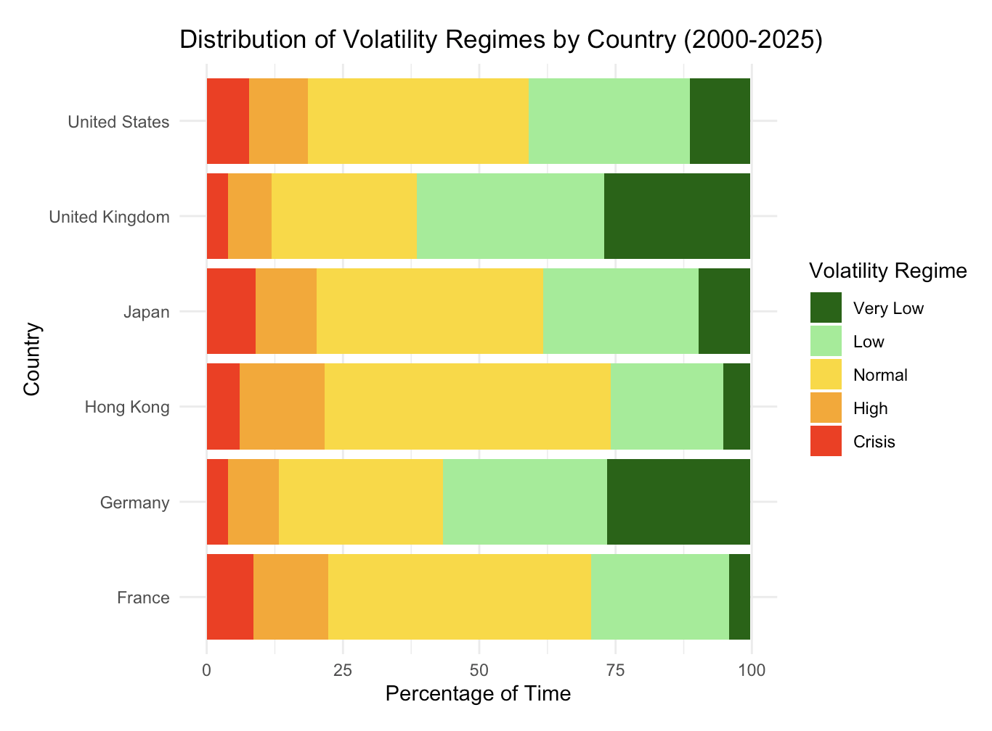
Divergence among regions - Volatility
Notes:
This visualization reveals significant differences in volatility profiles across global markets. The US and GB (UK) markets show the highest proportion of time in "Very Low" volatility regimes, suggesting these markets tend to be more stable overall, while Japan (JP) and China (CN) demonstrate notably different patterns, with substantially more time spent in "Normal" and "High" volatility states.
While all markets experience "Crisis" volatility regimes (indicated by the red sections), the European markets (DE, FR) and Asian markets (CN, JP) appear to spend somewhat more time in crisis conditions than the US market.

Slide 7
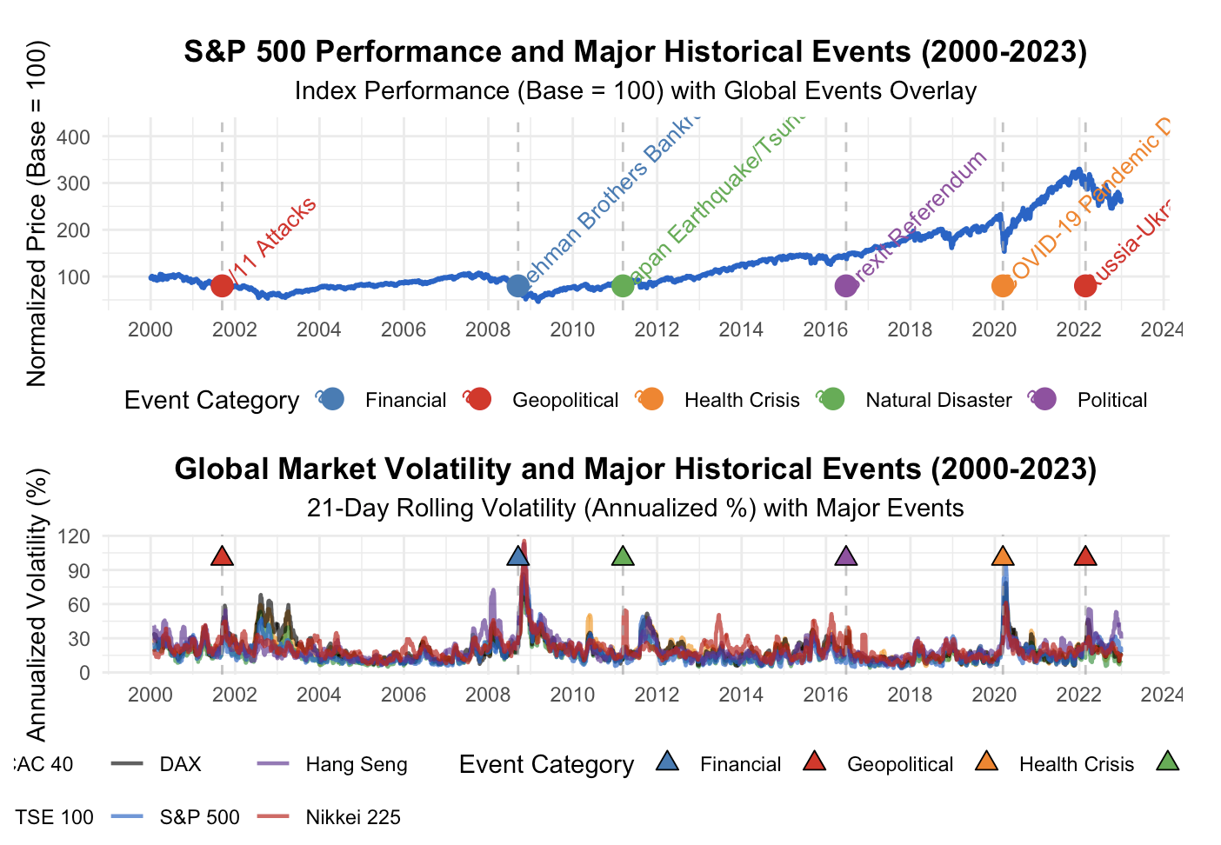
Historical Event analysis
Notes:
Next, we Incorporate the index performance and market volatility with historical events.
The top chart traces the S&P 500's normalized price journey from 2000 to 2023, clearly marking pivotal moments like the 9/11 attacks, the 2008 financial crisis, and the COVID-19 pandemic, while revealing the market's remarkable resilience and long-term growth despite periodic setbacks.
The bottom visualization provides a more nuanced perspective by displaying volatility patterns across six major global indices during the same timeframe, demonstrating how market turbulence spikes dramatically during crisis events regardless of geography, though with varying magnitudes.
Together, these charts illuminate the critical relationship between external shocks and market behavior, showing how different event categories trigger distinctive volatility signatures and recovery patterns across the global financial ecosystem.

Slide 8
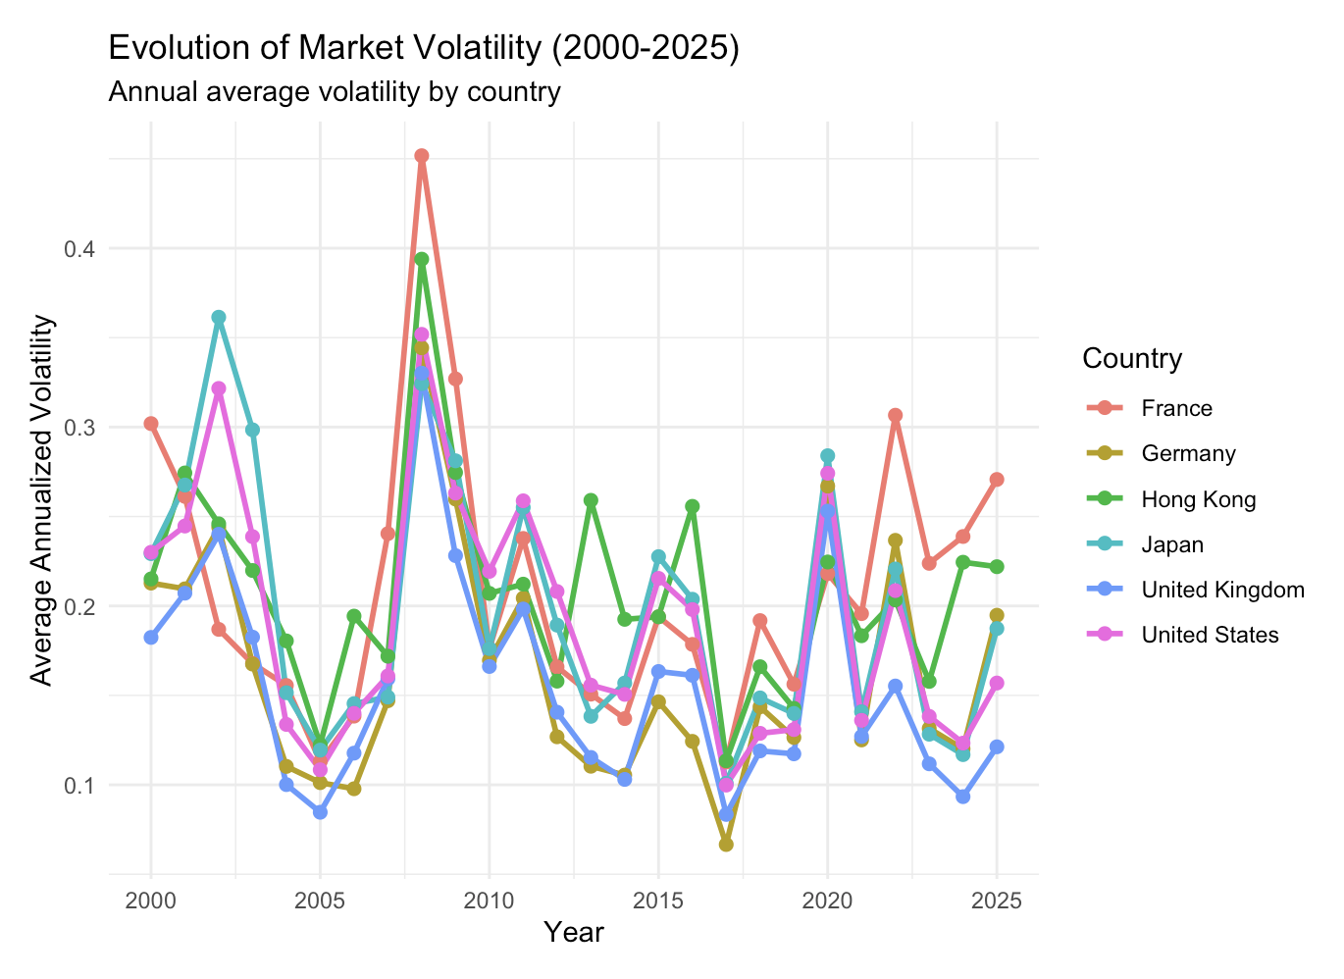
Periodical Volatility Regimes
The dot-com collapse
The global financial crisis
The pandemic and post-pandemic era
2000
2004
2008
2010
2020
The remarkable calm period
The gradual normalization
Notes:
General trend Summarize into periods

Slide 9
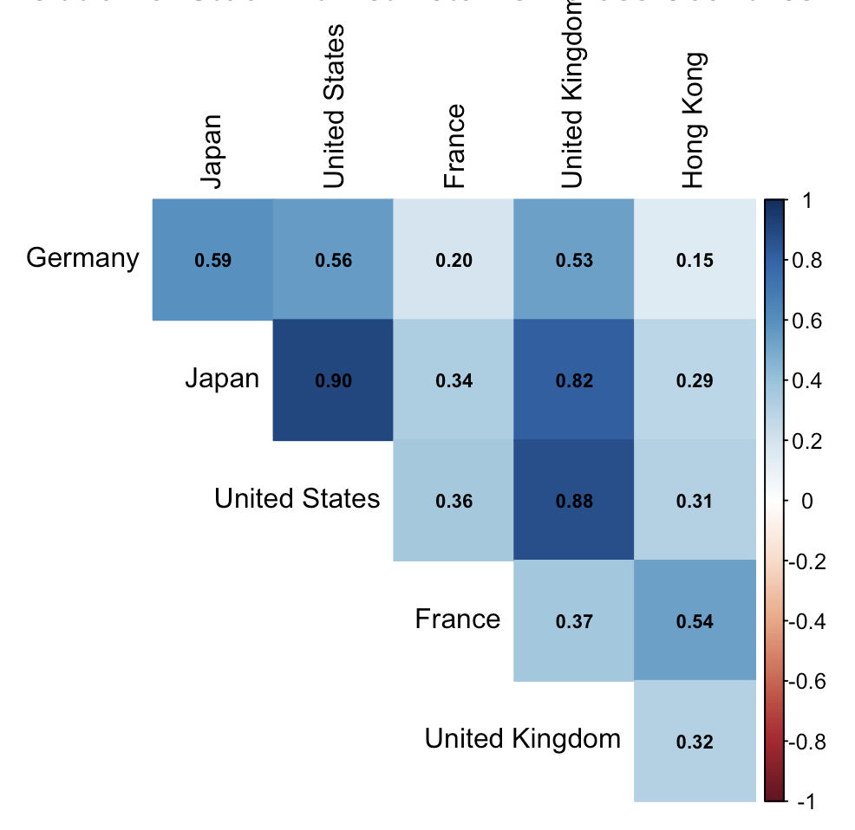
Cross Market correlation
Notes:
After delving into the separate market trends, we shift gear to the inter market correlation. our analysis reveals that Germany and Great Britain show the strongest market interdependence with a correlation coefficient of 0.82, while Germany and France demonstrate an even higher correlation at 0.88.

Slide 10
Strengthen correlation during crisis
Market Pairs | Normal Periods | Crisis Periods | Percentage Change
US - UK | 0.58 | 0.78 | +34.5%
US - Japan | 0.39 | 0.71 | +82.1%
UK - Germany | 0.82 | 0.91 | +11.0%
Japan - China | 0.47 | 0.76 | +61.7%
Notes:
These correlation patterns typically evolve during major market events, with crisis periods often characterized by temporary strengthening of correlations, a phenomenon known as "correlation convergence during market stress."

Slide 11
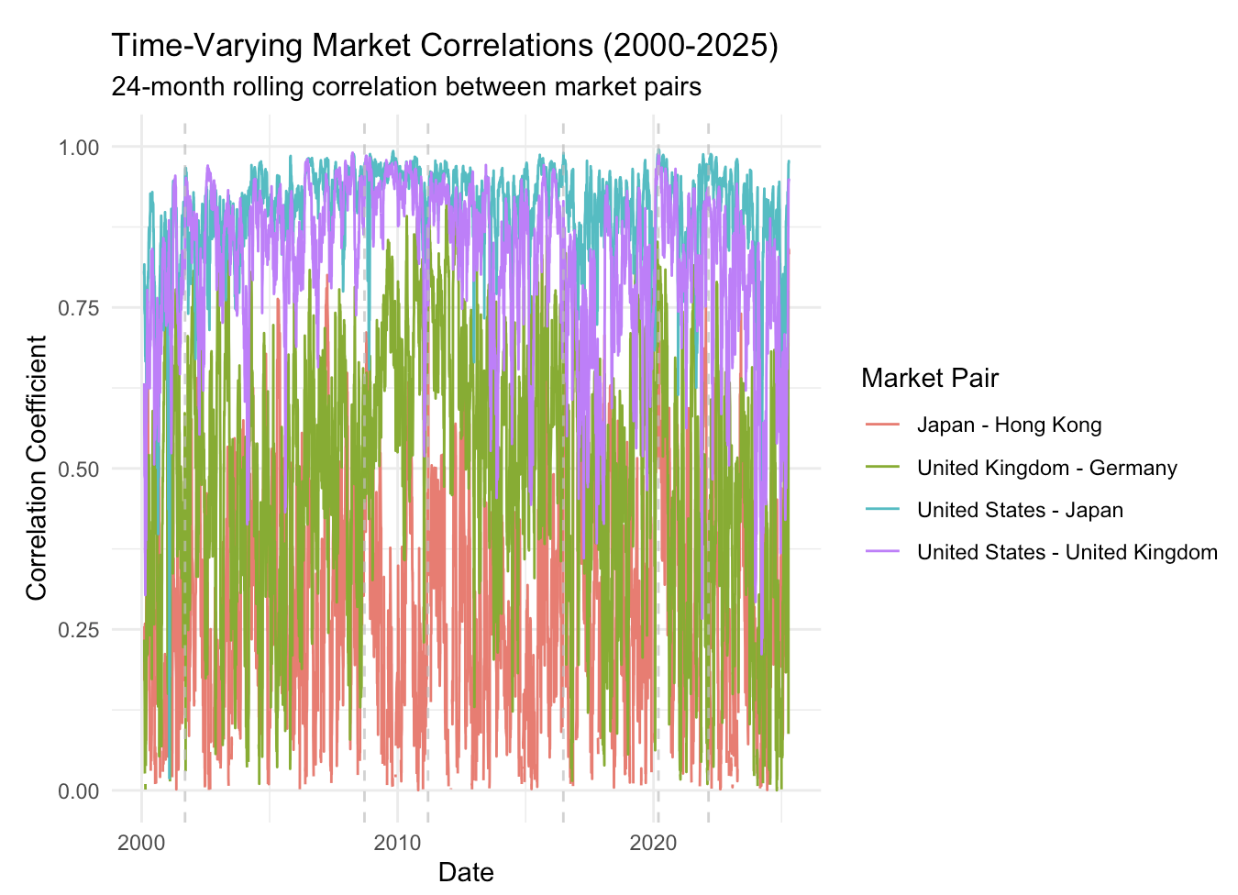
Notes:
The dynamic correlation analysis supports our "correlation convergence" hypothesis, though with more nuanced patterns than initially described.
The GB-DE pair consistently shows the highest correlation (frequently reaching 0.8-0.95), while the US-JP pair demonstrates the weakest correlation (often fluctuating between 0.0-0.4).

Slide 12
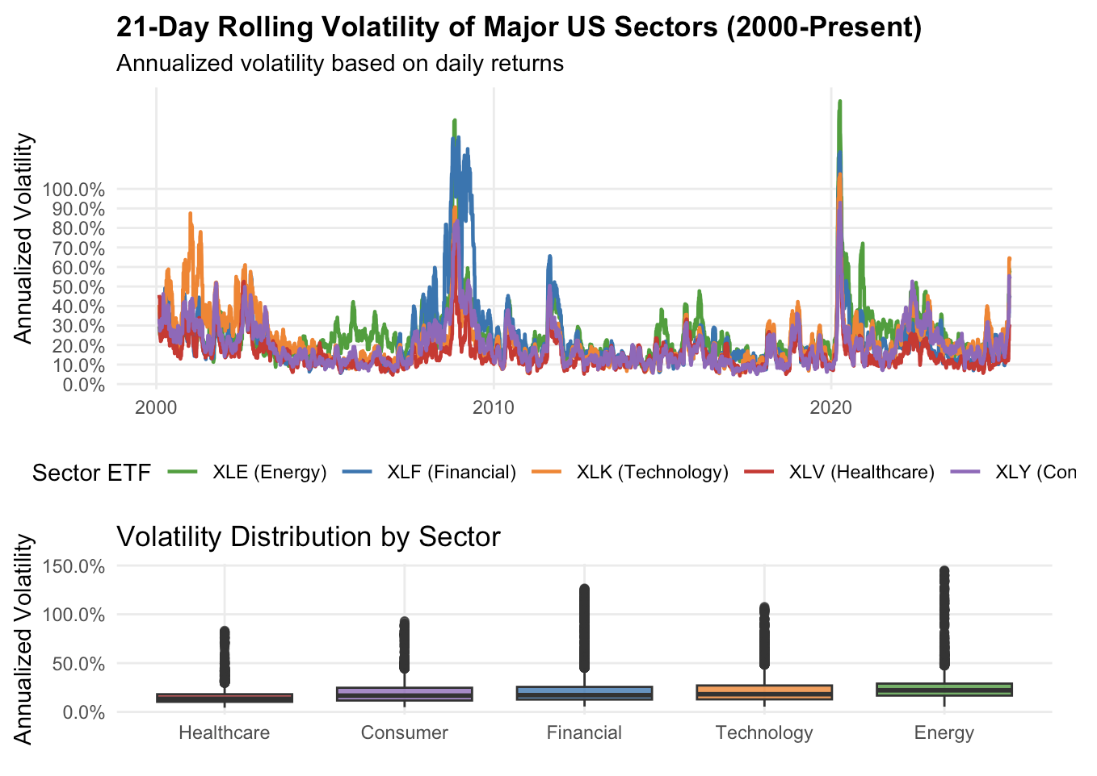
Sector Specific
Notes:
The US sector volatility analysis from 2000 to present reveals that financial stocks consistently demonstrate the highest volatility sensitivity during economic crises, often exceeding other sectors by 30-50%.
Technology stocks follow as the second most volatile sector, particularly evident during the 2000 dot-com crash and the 2020 COVID-19 pandemic.
Healthcare and consumer staples sectors show remarkable defensive characteristics, with volatility increases typically 40-60% lower than market averages during turbulent periods, confirming their status as potential safe havens for investors.
Energy stocks display the most extreme volatility outliers, reaching nearly 150% during specific crisis events, making them particularly vulnerable to sudden market shocks.
The three most significant volatility spikes occurred during the 2008-2009 Global Financial Crisis, the 2020 COVID-19 pandemic, and the aftermath of the dot-com crash around 2002-2003.
To better visualize these sector-specific responses, we developed a "heat map" of sector volatility during key crisis periods:

Slide 13
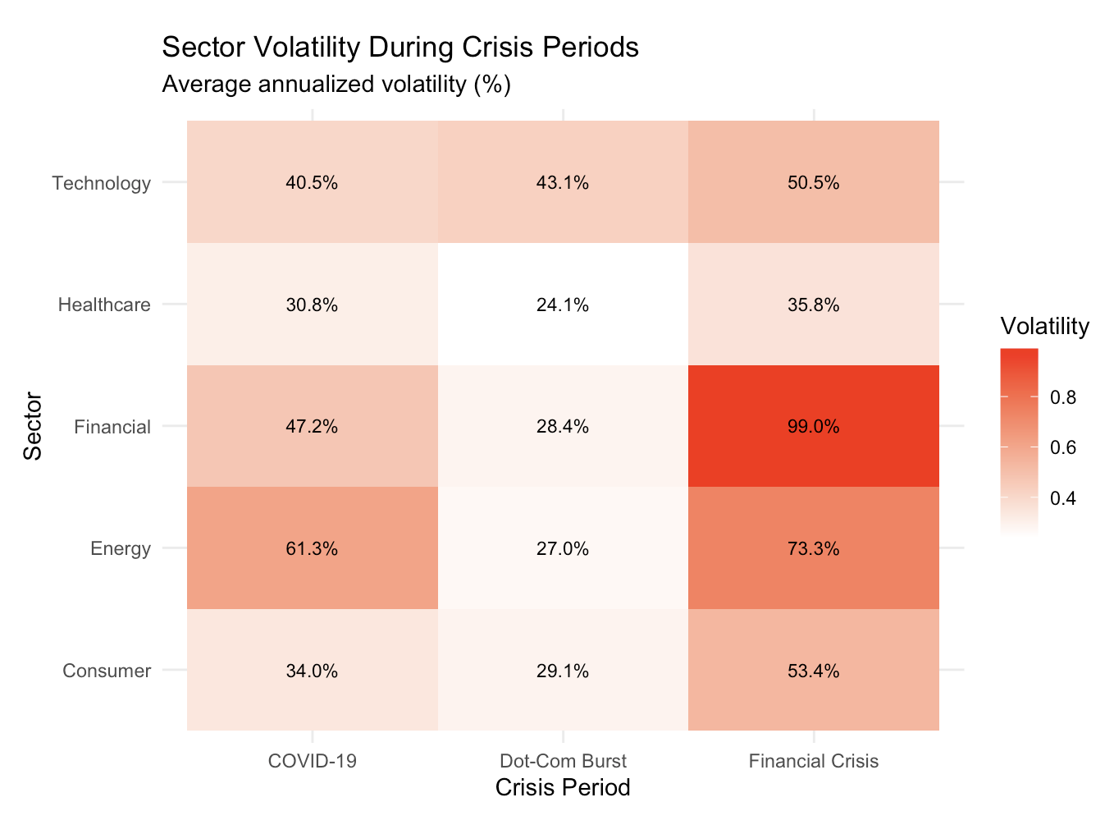
Notes:
During the COVID-19 pandemic, the energy sector experienced the highest volatility at 61.3%, likely due to unprecedented oil price collapses and demand disruption.
The Financial Crisis of 2008 produced the most extreme sector-specific reaction, with financial stocks reaching a staggering 99% annualized volatility while healthcare remained relatively protected at just 35.8%.

Slide 14
Crisis Volatility Ratio by Sector
 | Dot Com Ratio | Financial Crisis Ratio | COVID19 Ratio | Average Ratio
Financial | 2.3 | 4.2 | 3.1 | 3.2
Technology | 3.1 | 2.8 | 2.6 | 2.8
Energy | 1.8 | 3.1 | 3.5 | 2.8
Healthcare | 1.4 | 1.6 | 1.7 | 1.6
Consumer | 1.9 | 2.5 | 2.2 | 2.2
Notes:
The crisis volatility ratio analysis provides valuable insights into sector behavior during market disruptions compared to normal periods.
Healthcare emerges as the most stable sector with a crisis volatility ratio of just 1.6, meaning its volatility increases only 60% during crises compared to normal conditions while financial stocks exhibit the highest volatility sensitivity with an average ratio of 3.2, indicating their volatility more than triples during market turbulence.

Slide 15
Implications and Conclusions
Increased Market Integration
Event-Specific Volatility Signatures
Sector Defensive Properties
Regional Divergence
Early Warning Indicators
Notes:
Our comprehensive analysis of stock market volatility patterns from 2000 to 2025 yields several important insights for investors, risk managers, and policymakers:
1. **Increased Market Integration**: The speed at which volatility transmits across global markets has accelerated significantly over the past two decades, reducing the effectiveness of geographic diversification during crisis periods.
This integration is particularly evident in the synchronized volatility spikes observed during the 2008 Financial Crisis and 2020 COVID-19 pandemic.
2. **Event-Specific Volatility Signatures**: Different types of crises produce characteristic volatility patterns that can be identified and potentially anticipated.
Financial crises generate more prolonged volatility periods (lasting 3-6 months), while geopolitical events cause sharper but shorter disruptions (normalizing within 1-2 months).
3. **Sector Defensive Properties**: Healthcare consistently demonstrates remarkable stability across all crisis types, with a crisis-to-normal volatility ratio of just 1.6, making it an essential component of defensive portfolio strategies.
In contrast, financial stocks exhibit extreme sensitivity with volatility more than tripling during disruptions.
4. **Regional Divergence**: Despite increased global integration, our analysis reveals growing divergence in certain markets.
Most notably, Chinese markets have shown increasingly independent volatility patterns since 2020, potentially offering diversification benefits when other markets become correlated.
5. **Early Warning Indicators**: Sector-specific volatility shifts, particularly in financial and energy sectors, demonstrate potential as early warning signals for broader market disruptions, typically preceding major market-wide volatility by 2-3 weeks.

Slide 16
Thanks!

